Slide 1
Building Community Networks to Improve Heart Health in Rural Communities
Brenda Miller & Kacie Kennedy, MPH
American Heart Association – Southeast
February 23, 2022
Notes:
KACIE

Slide 2
Notes:
KACIE

Slide 3
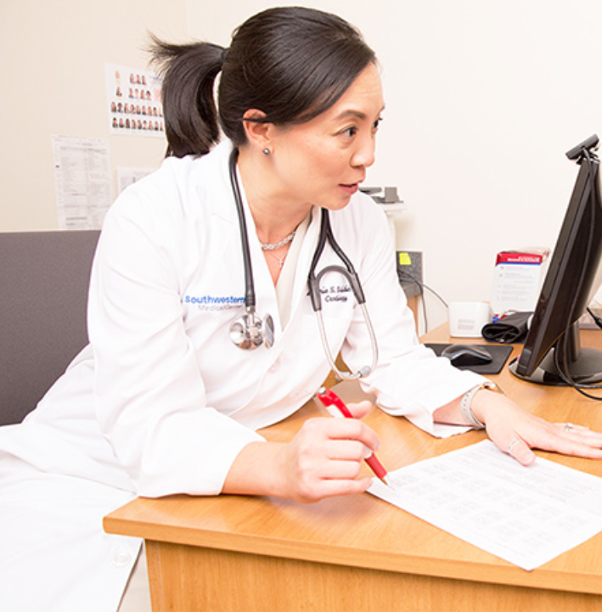
Heart Disease remains the No. 1 cause of death in the US, according to 2018 data.
Cardiovascular disease (CVD), listed as the underlying cause of death, accounted for 868,662 deaths in the US in 2017.
CVD claims more lives each year than all forms of cancer and Chronic Lower Respiratory Disease combined.
CVD is the leading global cause of death and accounted for approximately 18.6 million deaths in 2019.
Nearly half of American adults have high blood pressure. Many don’t even know they have it.
Notes:
BRENDA

Slide 4
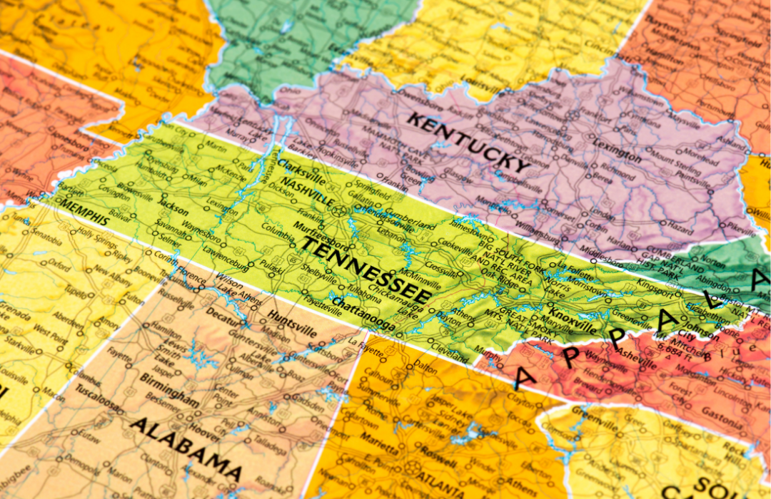
Cardiovascular Disease & Blood Pressure in Rural Tennessee
For the state of Tennessee, the CDC data shows 17,943 heart disease deaths in 2020 and 3,435 stroke deaths in 2019.
42% of adults in rural TN have high blood pressure.
54.6% of adults in rural TN with an income less than $25,000/year have high blood pressure.
Notes:
BRENDA

Slide 5
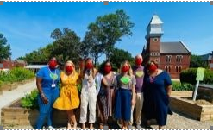
Meeting People Where They Are
Library
Church
Grocery Store
Notes:
BRENDA

Slide 6
BP Control Techniques
For every 2mmHG decrease in blood pressure the risk of a cardiovascular event is decreased 7% and stroke 10%.
Primary Care Physician/Health Care Center Diagnosis and regular follow-up checks.
Health Care Center Self-Managed Blood Pressure –
Patient is trained to take BP with a validated in-home monitoring device, checks BP at home according to schedule.
Via telemed or in-office appointment patient reports reading to provider, provider then provides feedback to patient.
2012 study showed patients who self-monitor BP on regular basis (minimum of 2x/month for four consecutive months) consistently reduced both systolic and diastolic BP levels.
Community Screen and Refer programs –
Community location provides visitors with access to BP equipment on a regular basis.
BP reading is taken at a community location by trained volunteer.
Those with elevated BP are referred to Primary care physician or clinical partner for follow up, treatment, and further education.
Notes:
KACIE

Slide 7
BP Screen and Referral
Systematic screening/education opportunities in community setting with trained staff or volunteers – at least monthly opportunity
Direct connection/established partnership with health provider and/or health center
Access to validated equipment for blood pressure readings
Written plan for communicating with and referring patients as needed to clinical care.
Notes:
KACIE

Slide 8
Questions?
Notes:
BRENDA/KACIE

Slide 9
Contact Us!
Brenda Miller
Community Impact Consultant
Brenda.Miller@heart.org
Kacie Kennedy
Community Impact Manager
Kacie.Kennedy@heart.org

