Slide 1
TN Adolescent Pregnancy Prevention Program (TAPPP) in the Northeast Region
Sarah Boop, RN, MPH │ Epidemiologist

Slide 2

Overview
What is TAPPP?
  Program Overview
  Goals and objectives for TAPPP
  Health educators’ role
Teen Pregnancy in Northeast TN
  Data & Trends

Slide 3

TN Adolescent Pregnancy Prevention Program (TAPPP)
What is TAPPP?
“The Tennessee Adolescent Pregnancy Prevention Program (TAPPP) is a state funded program that incorporates community-based awareness and prevention education through community services, education, collaborations and partnerships.”

Slide 4

TAPPP Primary Goals
Reduce the incidence of teen pregnancy in Tennessee
Promote total community involvement
Improve and coordinate services available for pregnant teenagers and teen parents
Notes:
Reduce the Incidence of Teen Pregnancy in Tennessee
Provide information, program, strategies and activities for parents, teens and educators in the community
Promote Total Community Involvement
Raise awareness of the issues dealing with teen sexuality thru partnerships and coalitions
Improve and Coordinate Services Available for Pregnant Teenagers and Teenage Parents
Collaborate with community youth serving agencies and local media outlets to provide resources, increase developmental assets, and awareness related to the needs of youth and teens.

Slide 5

Health Educators & TAPPP
Provide school-based health education curricula in compliance with TN Health Education Standards and TN laws
Provide community-based health education programs in conjunction with partner agencies
HealthSmart curriculum
Centerstone Teen Sexual Health Education Toolkit
Notes:
Our health educators provide K-12 health education in to build knowledge, skills, and behaviors needed to improve overall health and wellbeing, but also reduce teen pregnancy. The lessons provided are in compliance with TN Health Education Standards and TN laws governing family life planning and abstinence-based sexual health education in schools.

Slide 6






TN Health Education Standards
Grades K-5
Personal Wellness
Mental & Emotional Wellness
Disease Prevention
Safety
Human Growth and Development
Grades 6-8
Personal Wellness
Mental, Emotional, & Social Wellness
Safety & Disease Prevention
Human Growth & Development
Substance Use & Abuse
Grades 9-12
Personal Wellness
Mental, Emotional, & Social Wellness
First Aid & Safety
Human Growth & Development
Substance Use & Abuse
Notes:
The Tennessee Health Education and Lifetime Wellness Standards are divided into three (3) grade bands: Grades K-5, Grades 6-8, and Grades 9-12. Each set of standards was written by teams of Tennessee health education teachers and higher education faculty, as convened by the Tennessee Department of Education.
The Health Education and Lifetime Wellness Standards represent the knowledge or behavioral outcomes of a student at the completion of a grade or course. Creating developmentally appropriate learning experiences that meet the standard is the responsibility of the health education teacher and in alignment with school district documents. Each standard is observable and measurable and therefore can be assessed. Our health educators teach high quality health education curricula in our schools and community organizations in order to meet the health education standards set by the state.

Slide 7
HealthSmart K-12 Health Education Program
HealthSmart is a flexible and customizable health education curriculum, comprised of over 400 lessons, allowing school districts the autonomy for local decision making to ensure all lessons align to state and local policies.
The ultimate goal of the HealthSmart program is to promote the healthy growth and development of youth and give them the knowledge and skills to make healthy choices and establish life-long healthy behaviors.
Notes:
Benefits of HealthSmart:
Meets the National Health Education Standards.
Focuses on the primary areas of risk for children and adolescents identified and monitored by the Centers for Disease Control and Prevention (CDC).
Reflects the characteristics of an effective health education curriculum defined by the CDC.
Incorporates key knowledge and skill expectations detailed in the CDC's Health Education Curriculum Analysis Tool (HECAT) for each grade level.
Supports social and emotional learning (SEL).

Slide 8
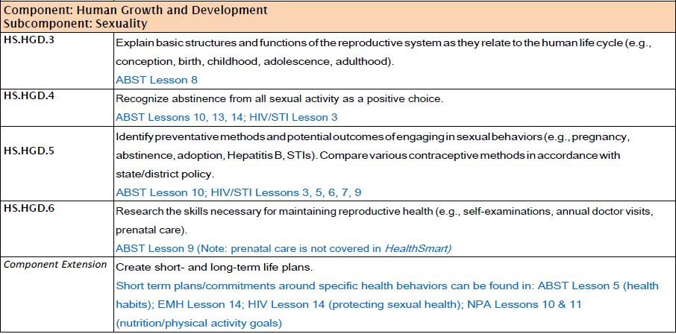
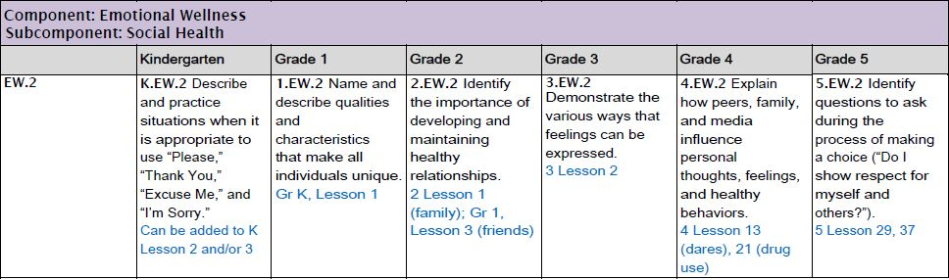
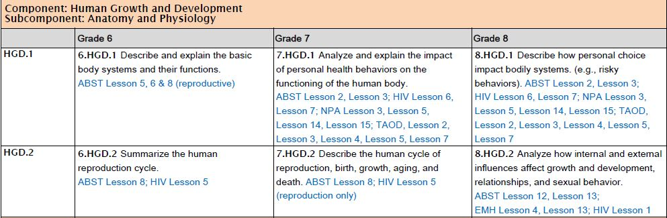
HealthSmart & TN Education Standards

Slide 9
Centerstone Teen Sexual Health Education Toolkit
Toolkit developed by Dept. of Health and Human Services Office of Adolescent Health—includes specific details about teaching family life planning in accordance with Tennessee laws
Medically accurate, age-appropriate information about pregnancy and STI/HIV prevention
Also used to expand services into community-based settings (Be Proud! Be Responsible! and Sexual Health and Adolescent Risk Prevention curricula)
  Juvenile justice centers, foster care, group homes, etc.
Notes:
This toolkit offers programming that is complaint with laws governing family life and abstinence-based education in schools, as well as providing an appendix for teaching comprehensive sexual health education outside of school-based settings.

Slide 10

Data Review
Tennessee
Northeast Region
County
Source: https://www.tn.gov/health/health-program-areas/statistics/health-data/birth-statistics.html
Notes:
Data obtained from TN Department of Health Birth Statistic site: Birth Statistics (tn.gov)
Limitation: most recent publicly available data is from 2018 or 2019 depending on the variable.
SOURCE: TENNESSEE BIRTH, FETAL DEATH, AND INDUCED TERMINATION OF PREGNANCY STATISTICAL FILES, 2019, TENNESSEE DEPARTMENT OF HEALTH, DIVISION OF VITAL RECORDS AND STATISTICS. RATES CALCULATED BASED ON TOTAL POPULATION COUNTS FROM THE TENNESSEE POPULATION ESTIMATES PROGRAM, 2019, TENNESSEE DEPARTMENT OF HEALTH, DIVISION OF POPULATION HEALTH ASSESSMENT.
SOME FIGURES NOT DISPLAYED ACCORDING TO THE TENNESSEE DEPARTMENT OF HEALTH GUIDELINES FOR RELEASE OF AGGREGATE DATA TO THE PUBLIC. NOTE: PREGNANCIES INCLUDE REPORTED FETAL DEATHS, INDUCED TERMINATIONS, AND LIVE BIRTHS

Slide 11
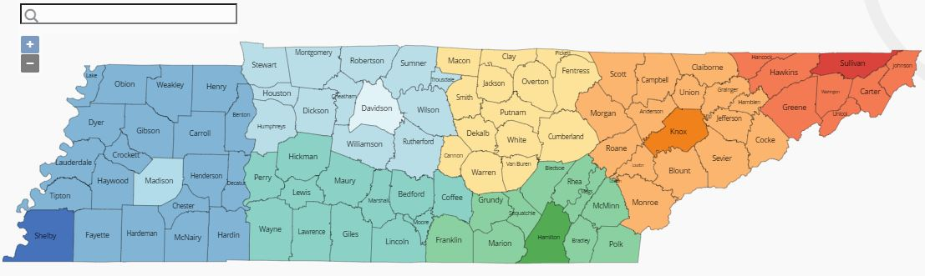

Northeast Tennessee
Carter, Greene, Hancock, Hawkins, Johnson, Unicoi, and Washington
Notes:
Every Tennessee county has a local health department and some of Tennessee's larger counties have multiple health department facilities. A total of 89, primarily rural, county health departments operate under the Tennessee Department of Health in Nashville. The TDH Commissioner appoints the directors for these 89 local health departments, grouped into seven regions and served by a TDH Regional Office. The public health services provided at the 89, rural health departments vary, reflecting population health needs and the capacity of funding available year-to-year.
Tennessee's six larger, urban counties – Madison, Shelby, Knox, Davidson, Hamilton and Sullivan – have health departments that operate under local governance, and also work closely with the Tennessee Department of Health. Directors of the six larger, urban county health departments are appointed by their county leadership. In some instances, a health board appointed by the mayor will provide recommendations regarding these appointments. Services provided the six, urban health departments vary, reflecting population health needs and the capacity of funding available from year to year. Here are links to the urban county health departments in Tennessee:

Slide 12
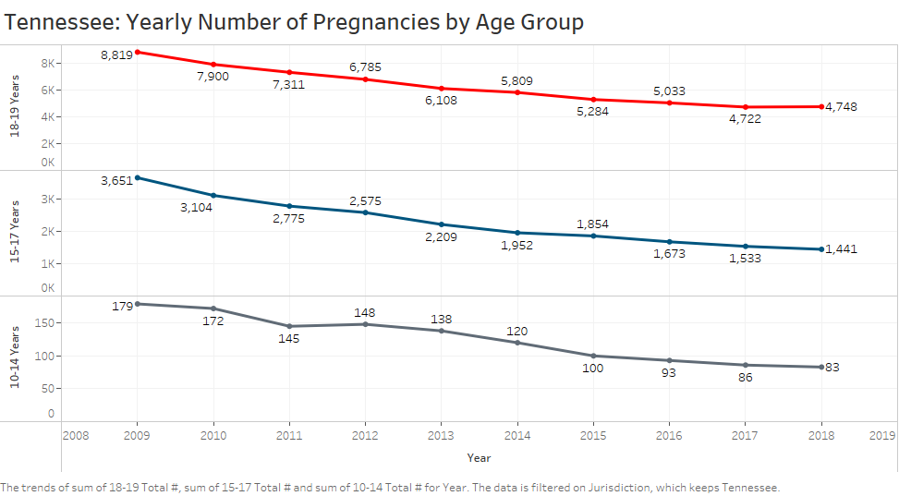

Slide 13
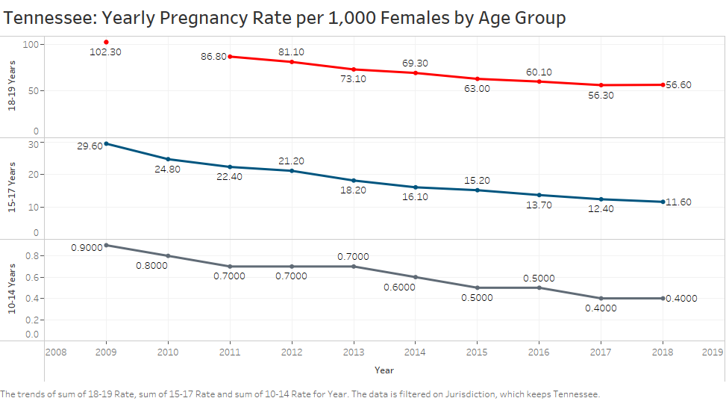

Slide 14
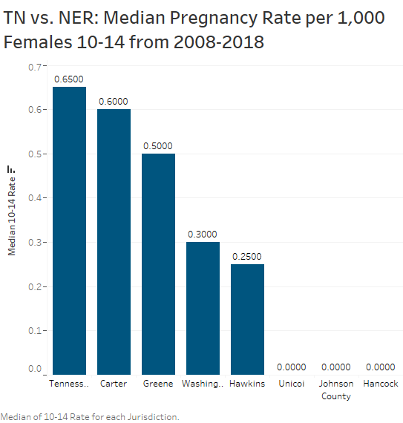
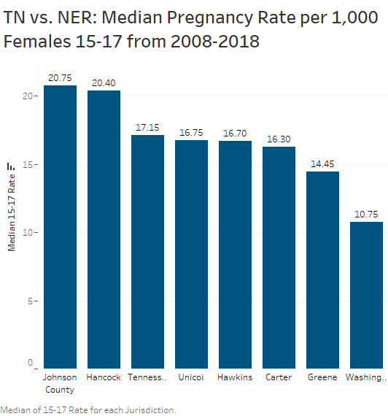
Notes:
Smaller counties may have data suppressed due to TDH data sharing and aggregation rules. This protects individuals who may be identifiable in smaller communities with fewer prengnacies.
Pregnancy rate for state for 10-14 year olds higher than that for counties in NER.
Johnson and Hancock counties have higher rates in 15-17 year old population than state overall.

Slide 15
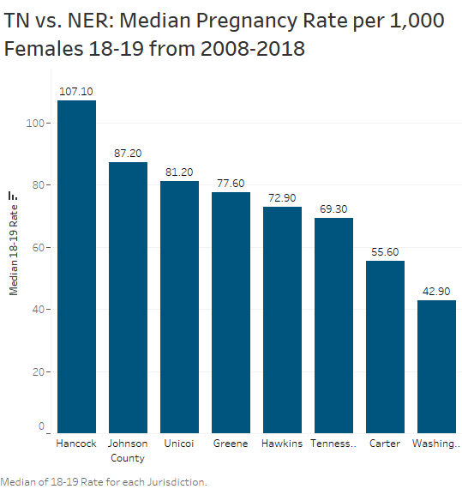
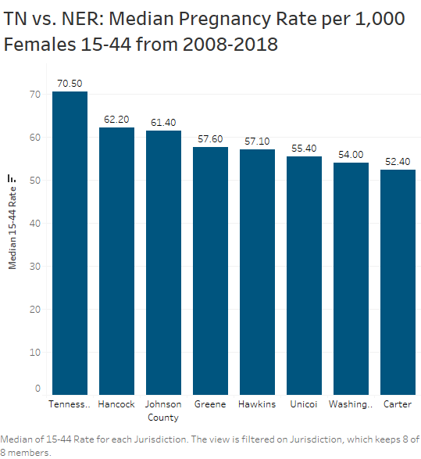
Notes:
For 18-19 year olds, most of NER rates are higher than the state median rate.
When you expand population to 15-44 year olds, pregnancy rate for state higher than for NER counties.

Slide 16
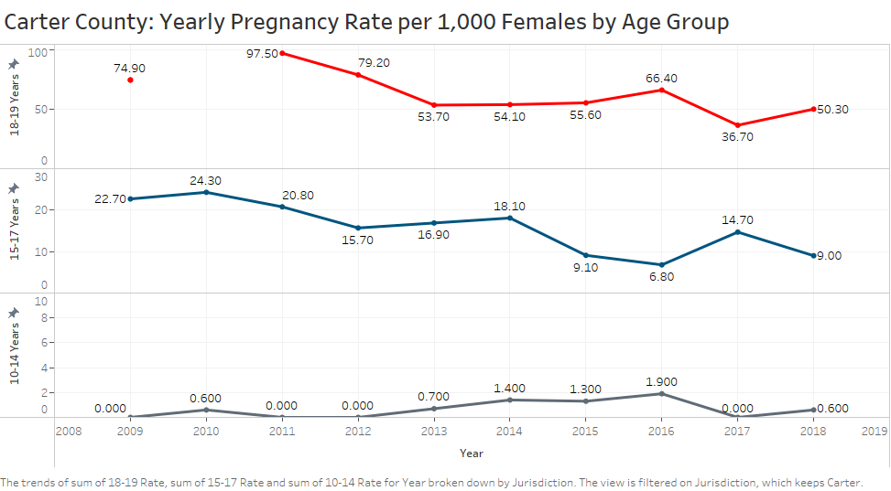
Notes:
Trends:
Overall, downward trends for 18-19 and 15-17 year age groups
Slight increase in 10-14 year group

Slide 17
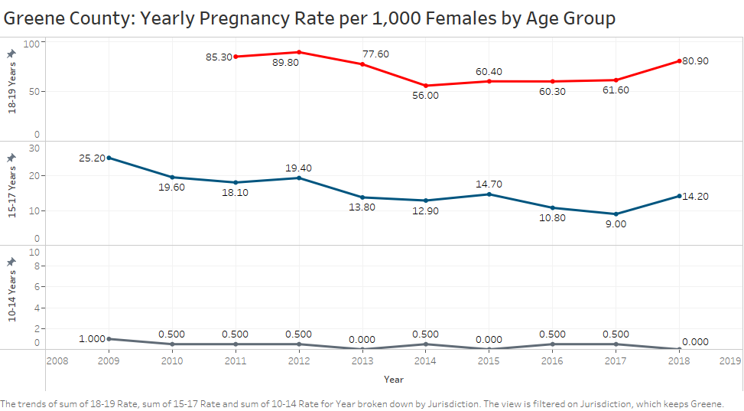
Notes:
Overall downward trend in all age groupings

Slide 18
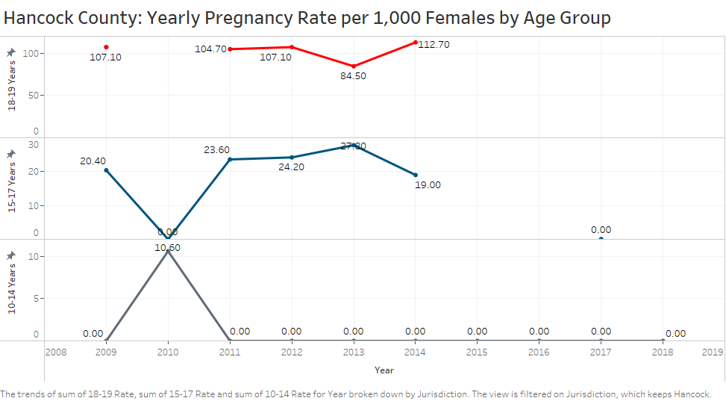
Notes:
Overall downward trend for 10-14 and 15-17, steady for 18-19 group.

Slide 19
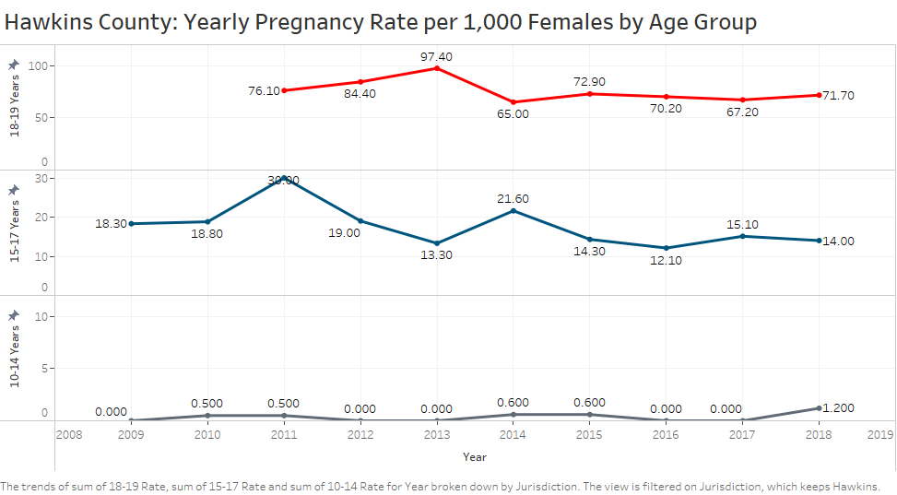
Notes:
Downward or steady for all age groups.

Slide 20
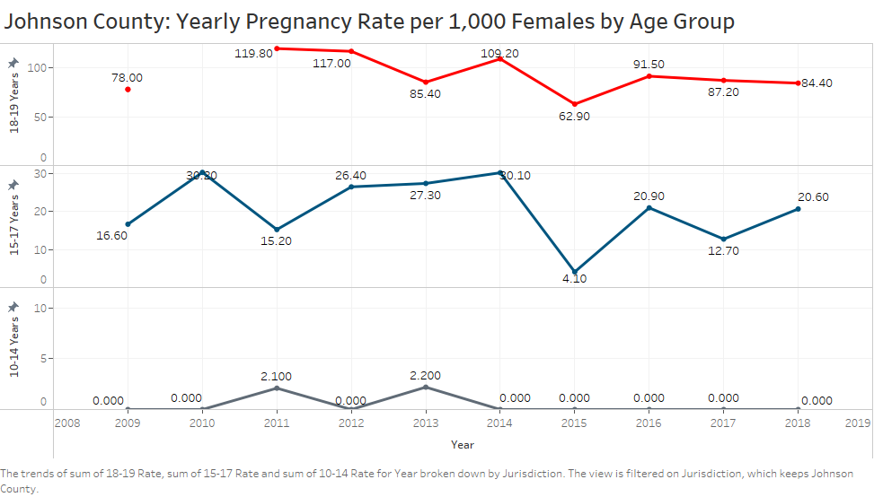
Notes:
Overall slightly downward trend for all groups, however for 15-17 year olds, some of that could be due to abnormally low # reported 2015.

Slide 21
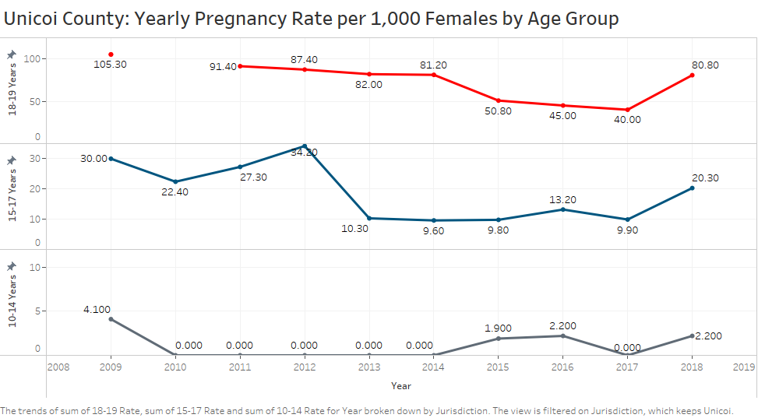
Notes:
Overall downward trends from 2009, but increases from 2017-2018 across all age groups is noteworthy.

Slide 22
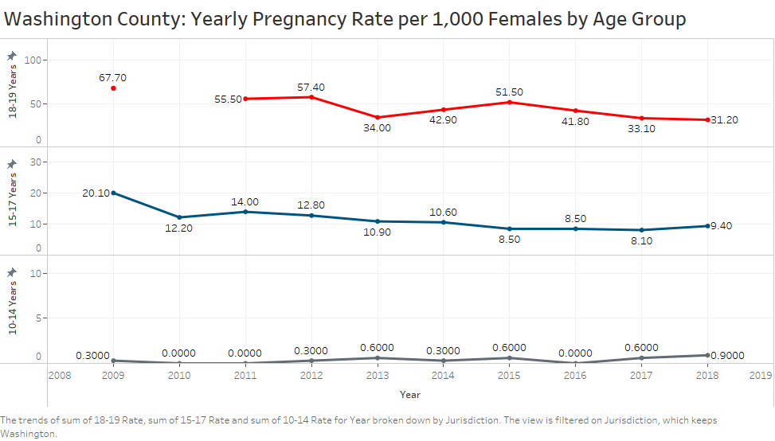
Notes:
Overall downward for 18-19 and 15-17, but slight increase overall for 10-14 years.

Slide 23

Key Points
TAPPP provides community services, education, collaborations, and partnerships to increase awareness community awareness and prevention of teen pregnancy.
Overall, NER teen pregnancy rates and county rates by age group trended downward from 2008-2019; however some age groups have seen increases in last year or two or data that may indicate increasing trend. Need up-to-date data.
Pregnancy rates per 1,000 for 15-17 and 18-19 year old categories in a number of NER counties are higher than overall state rate.

Slide 24


THANK YOU!
ANY QUESTIONS?

