Slide 1
Rural Obesity and Eating Disorders
Melissa Robinson M.D.
Rural and Community Programs

Slide 2
Disclosures
No conflicts of interest
No compensation from outside sources
Free from commercial bias
Notes:
I have no conflicts of interest.
I’m so glad you’re considering becoming a doctor. And why would you want to?

Slide 3
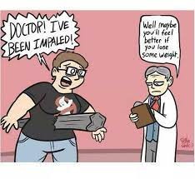
Learning Objectives
Identify and avoid anti-fat bias
Review data linking obesity to health risk factors, and consider discrepancies in interpretation
Identify rural factors contributing to, and resulting from, obesity
Be able to perform screening, brief intervention, and referral to treatment for patients with eating disorders

Slide 4
Pre-Quiz:
Why is fat-to-lean body composition important?
How do we measure it?
What are the best words to use when discussing these concepts?
What are some common eating disorders and how can you screen for them?

Slide 5
Terminology - Obese vs Fat, Overweight vs Large-Body
For me, and for many other fat people, reclaiming the word fat is about reclaiming our very bodies, starting with the right to name them. Fat isn’t a negative aspect of one’s body any more than tall or short…
Yes, fat is a term with baggage, especially with straight-size people. But while it may feel loaded to those straight-size people, it is a key step in the healing and liberation of many fat people…
Aubrey Gordon, author of “You Just Need to Lose Weight”
and 19 Other Myths About Fat People¹
Notes:
Obese is a clinical term many see as stigmatizing. Morbid obesity is offensive.

Slide 6
History of Focus on Body Size
2,000 years ago, Greek physician Galen: “bad humors” causes large bodies, and prescribed massage, baths, and “slimming foods” ¹
1800’s –mathematician Quetelet interested in “social physics” develop ht/wt2 as index of (northern European) “average man”²
1900’s – scales affordable, doctors started recording weight ¹
1920’s – Flapper dresses, thin “in vogue”. Thyroid med inappropriate rx’d for weight loss.¹
¹Brown, H. (2015). How Obesity Became a Disease. The Atlantic. Retrieved April 5, 2023 from https://www.theatlantic.com/health/archive/2015/03/how-obesity-became-a-disease/388300/
²Nuttall FQ. Body Mass Index: Obesity, BMI, and Health: A Critical Review. Nutr Today. 2015 May;50(3):117-128. doi: 10.1097/NT.0000000000000092. Epub 2015 Apr 7. PMID: 27340299; PMCID: PMC4890841.

Slide 7
History (cont’d)
1940s through 1990’s - Medical community increasingly viewed obesity as an issue requiring medical treatment ¹
1957 - Met Life height-weight charts in 1957 (to assess financial risk) ²
1970s – Nutrition and public health researcher Keys criticized Met Life height-weight charts and found Quetelet’s Index better correlated with disease statistics – called it BMI^{.2}
¹Brown, H. (2015). How Obesity Became a Disease. The Atlantic. Retrieved April 5, 2023 from https://www.theatlantic.com/health/archive/2015/03/how-obesity-became-a-disease/388300/
²Nuttall FQ. Body Mass Index: Obesity, BMI, and Health: A Critical Review. Nutr Today. 2015 May;50(3):117-128. doi: 10.1097/NT.0000000000000092. Epub 2015 Apr 7. PMID: 27340299; PMCID: PMC4890841.

Slide 8
History (cont’d)
2013 – AMA members voted to consider obesity a “disease”, against the recommendation of its Committee on Science and Public Health who stated
  Doesn’t fit definition - No symptoms, not always harmful
  It’s a normal body function – the problem lies elsewhere
  Medicalizing obesity could increase stigma and push some people into unnecessary treatment¹
¹Brown, H. (2015). How Obesity Became a Disease. The Atlantic. Retrieved April 5, 2023 from https://www.theatlantic.com/health/archive/2015/03/how-obesity-became-a-disease/388300/

Slide 9
Health effects of obesity
2016 Meta-analysis of 72 studies: Grade 2 and 3 obesity associated with significantly higher all-cause mortality, but Grade 1 was not, and overweight was protective.¹
BMI < 18.5 underweight
BMI 25-30 overweight
Class 1 obesity: BMI of 30 to < 35
Class 2 obesity: BMI of 35 to < 40
Class 3 obesity: BMI of 40 or higher. Class 3 obesity is sometimes categorized as “severe” obesity.
More on BMI later!
¹Flegal KM, Kit BK, Orpana H, Graubard BI. Association of all-cause mortality with overweight and obesity using standard body mass index categories: a systematic review and meta-analysis. JAMA. 2013 Jan 2;309(1):71-82. doi: 10.1001/jama.2012.113905. PMID: 23280227; PMCID: PMC4855514.

Slide 10
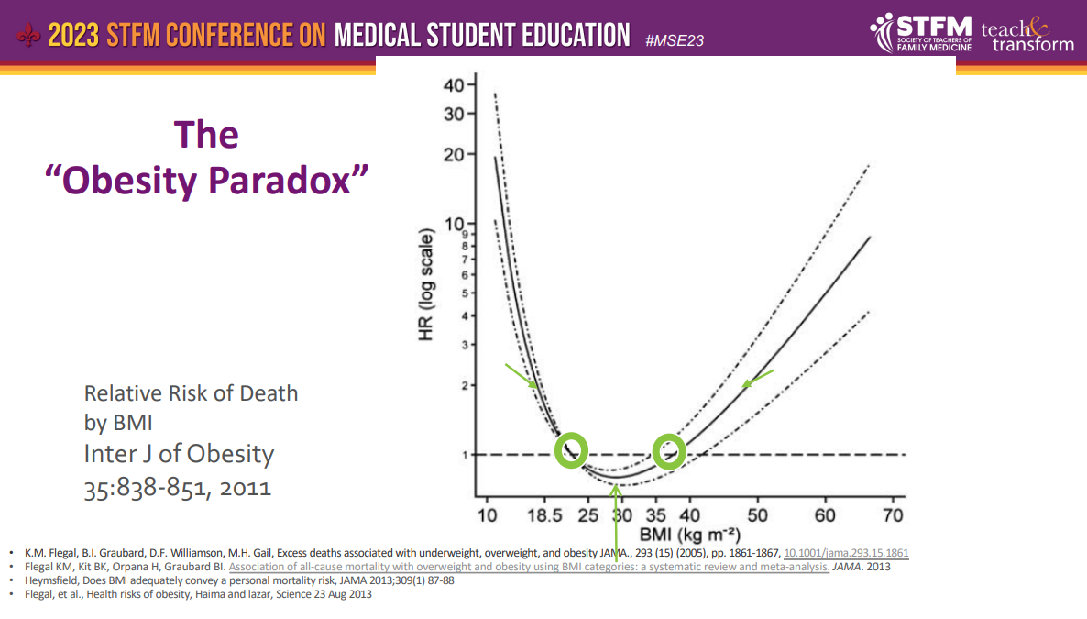
Erlanger, L. (2023, Jan 26-29). The Weight of Bias: Anti-Fat Bias, Health, and Medical Education [Conference presentation]. Society for Teachers of Family Medicine 2023 Conference on Medical Student Education, New Orleans, LA, United States.

Slide 11
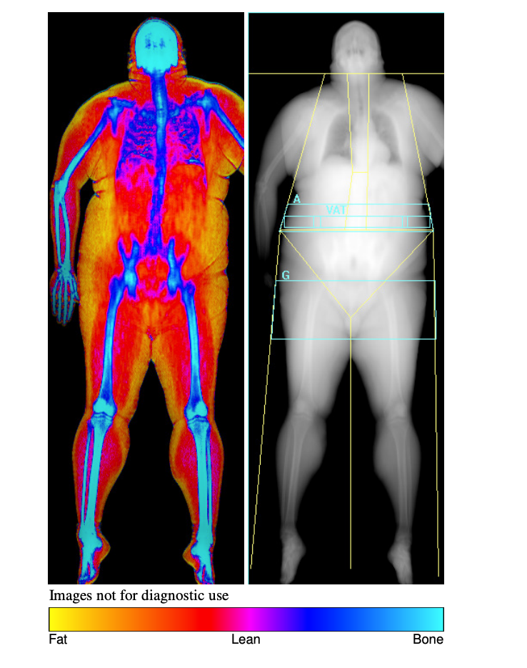

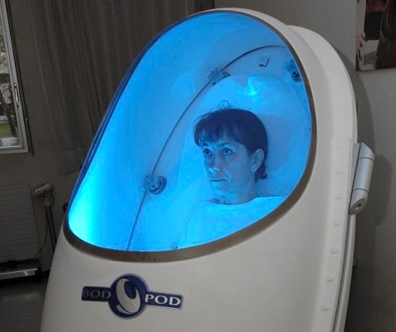
Tools to measure body composition
Water Displacement
Air Displacement
DEXA
Notes:
All are pricey

Slide 12
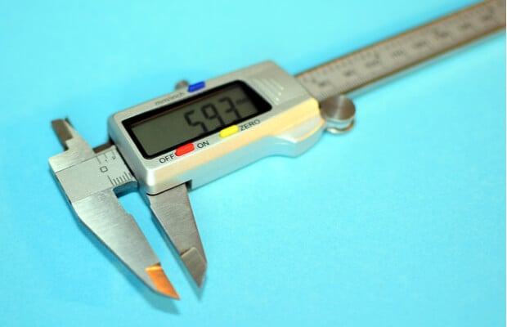
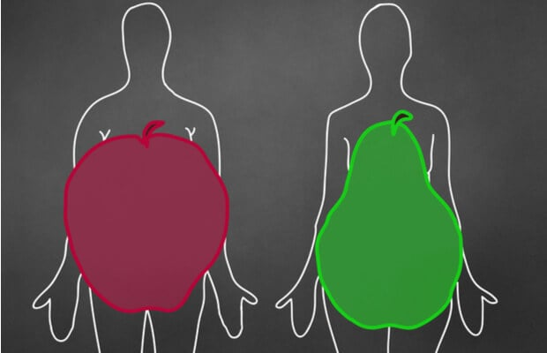
Tools to measure body composition
Waist to Hip Ratio
Calipers on skin fold in 3 areas – “best trade-off between cost, convenience and accuracy” per British Heart Foundation¹
¹British Heart Foundation (n.d.). What’s the Best Way to Measure Body Fat? Retrieved April 5, 2023 from https://www.bhf.org.uk/informationsupport/heart-matters-magazine/nutrition/weight/best-way-to-measure-body-fat#:~:text=Calipers%20are%20the%20cheapest%2C%20easiest,test%20on%20the%20same%20side.
Notes:
Water displacement, air displacement, very accurate, $$$$$. DEXA, quite good but $$$, waist circumf and waist-to-hip ratio – gotta know where to measure.

Slide 13
32-study review of tools to measure body composition:
More on BMI…
And waist circumference
For whom is BMI not very accurate?
Many, including children, pregnant, and muscular people.
“BMI and weight circumference have serious limitations for use as obesity screening tools in clinical practice despite their widespread use…However, due to the lack of more accurate and feasible alternatives, [they] might still have a role as initial tools for assessing individuals for excess adiposity until new evidence emerges.”
Sommer I, Teufer B, Szelag M, Nussbaumer-Streit B, Titscher V, Klerings I, Gartlehner G. The performance of anthropometric tools to determine obesity: a systematic review and meta-analysis. Sci Rep. 2020 Jul 29;10(1):12699. doi: 10.1038/s41598-020-69498-7. PMID: 32728050; PMCID: PMC7391719.

Slide 14
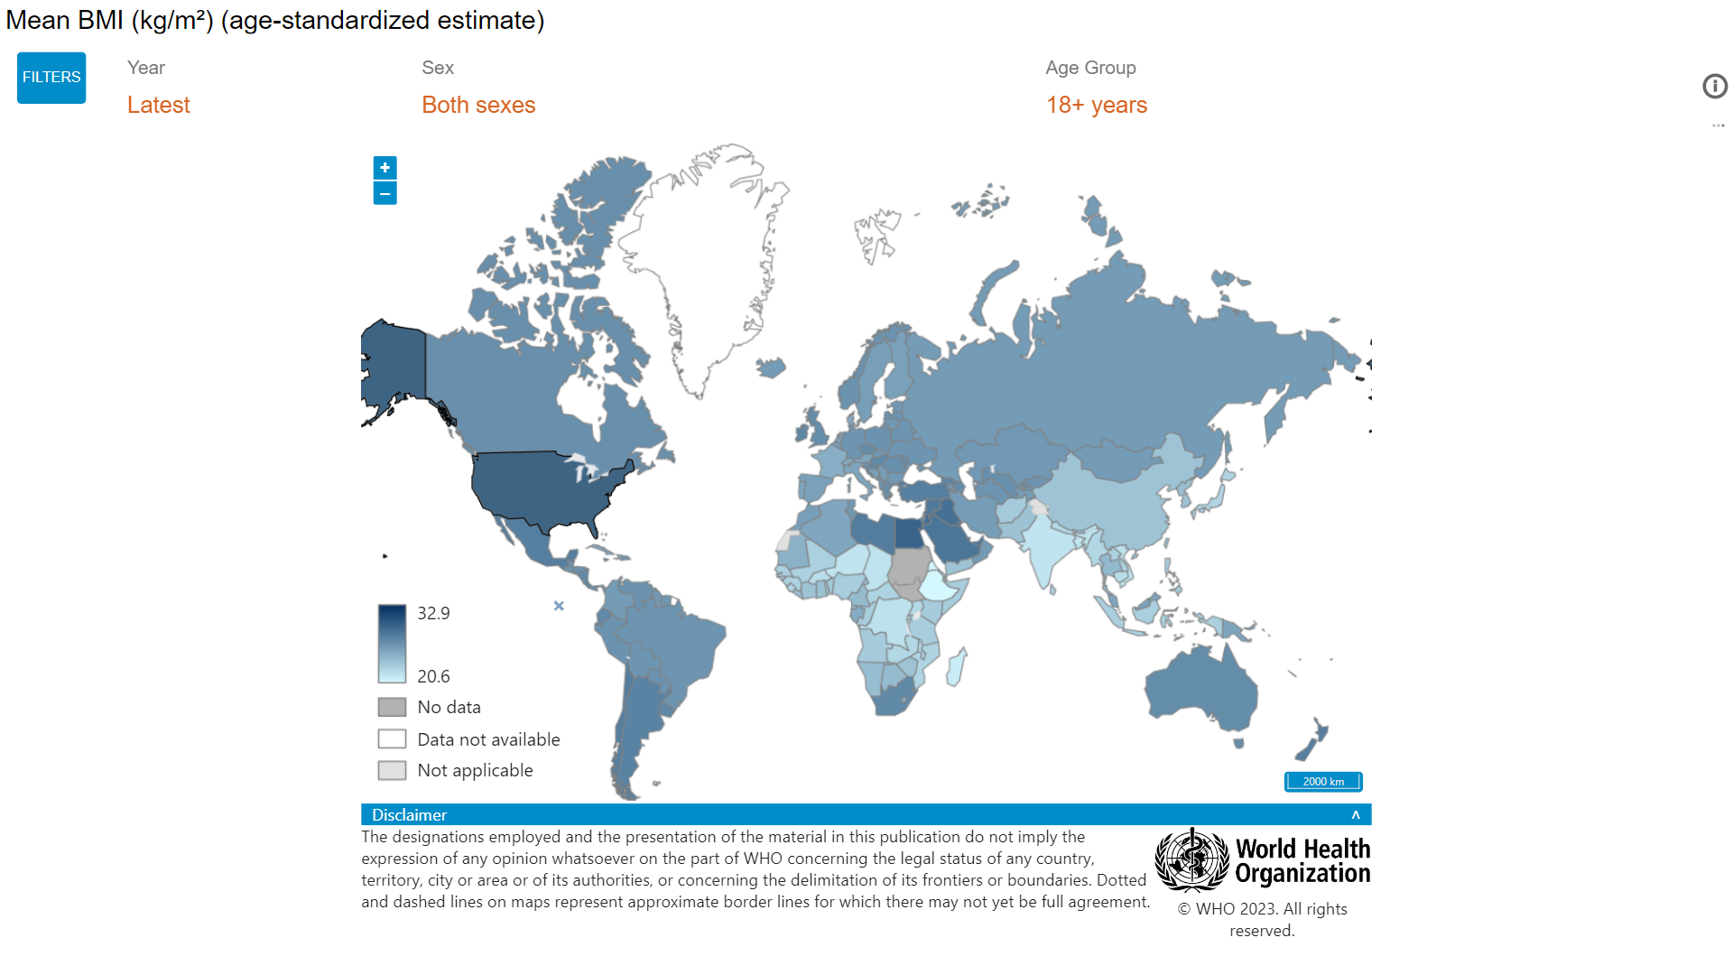
What countries have the highest BMI?
Mean BMI 2016
(https://www.who.int/data/gho/data/indicators/indicator-details/GHO/mean-bmi-(kg-m-)-(age-standardized-estimate) accessed 4/5/23)

Slide 15
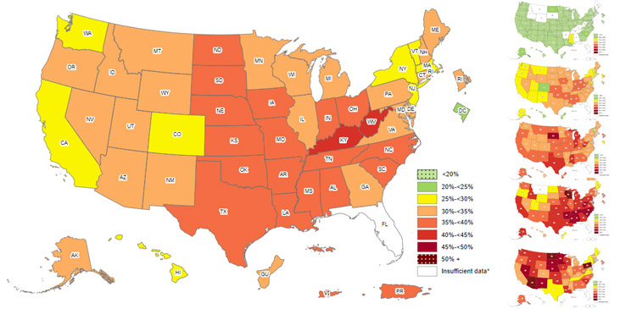
Obesity Prevalence
The US obesity prevalence was 41.9% in 2017 – March 2020. (NHANES, 2021)
From 1999 –2000 through 2017 –March 2020, US obesity prevalence increased from 30.5% to 41.9%. During the same time, the prevalence of severe obesity increased from 4.7% to 9.2%. (NHANES, 2021)
https://www.cdc.gov/obesity/data/adult.html

Slide 16
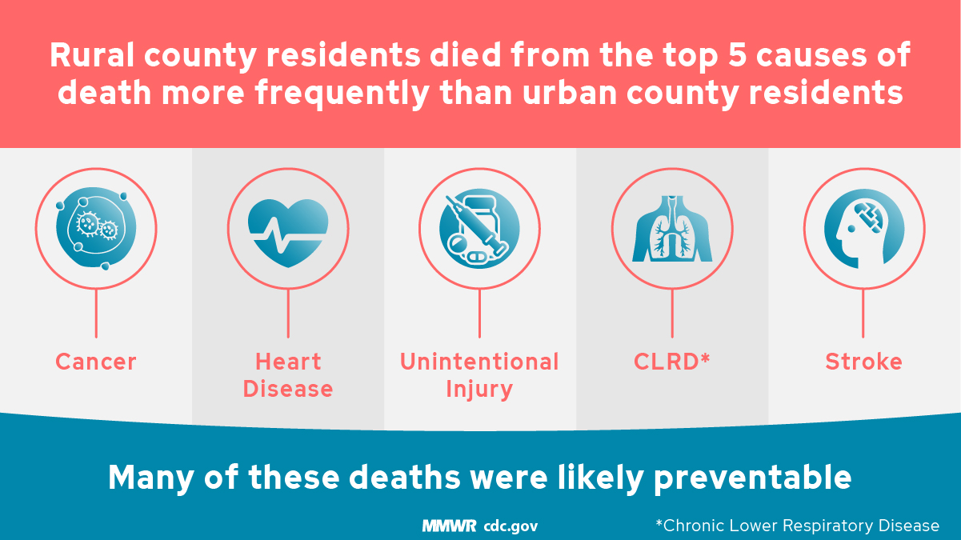

Slide 17
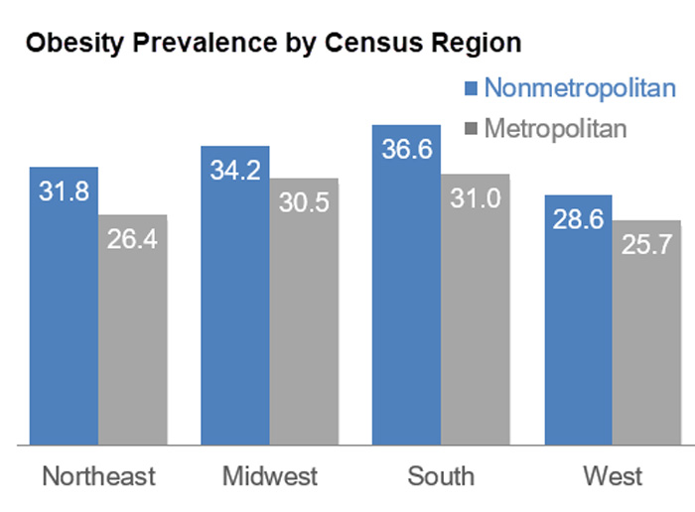
Rural areas experience higher rates of obesity
Many lack resources such as nutritionists, dietitians, access to physical activity.
Access to healthy and affordable food may be limited and travel may be a barrier.
https://www.ruralhealthinfo.org/topics/obesity-and-weight-control

Slide 18
What are some factors affecting obesity prevalence?
Rurality
Marketing/financial gain
Society
Genetics!!!!
Socioeconomics
Race/Ethnicity
Level of education
More!!!
Disease
or
Social Driver of Health?

Slide 19
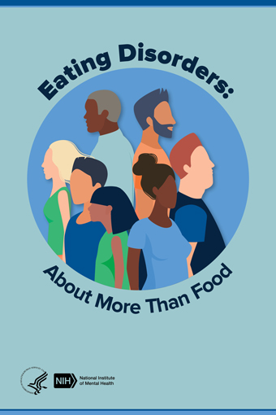
Body Size
≠
Eating Disorder!!!!

Slide 20
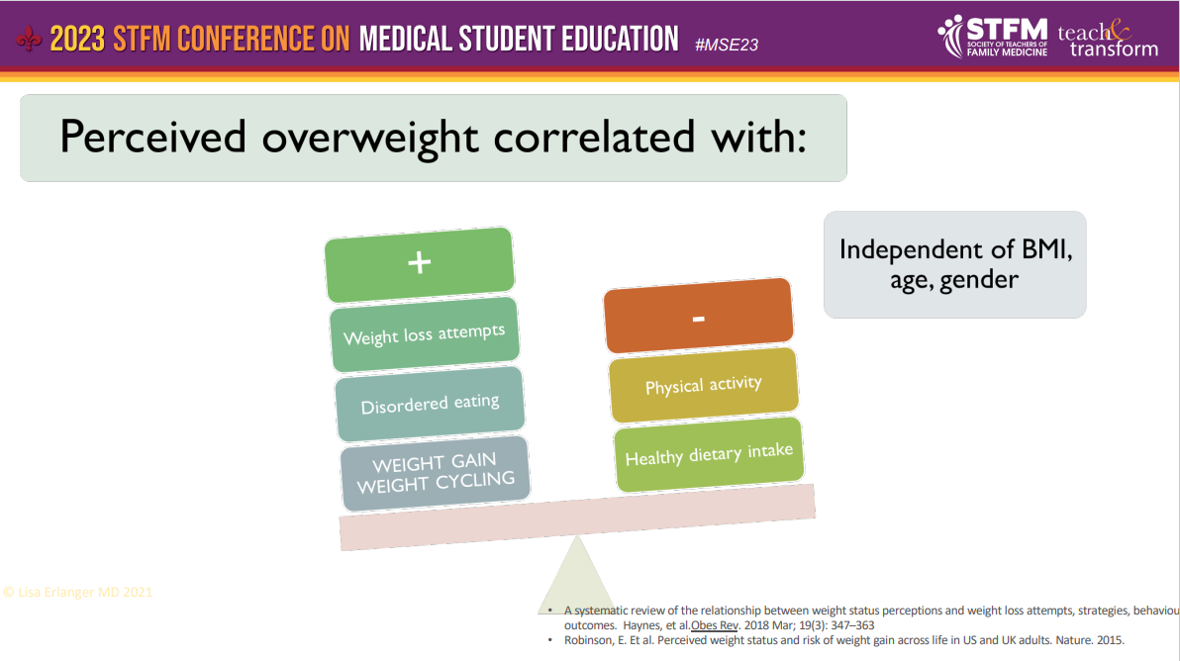
Erlanger, L. (2023, Jan 26-29). The Weight of Bias: Anti-Fat Bias, Health, and Medical Education [Conference presentation]. Society for Teachers of Family Medicine 2023 Conference on Medical Student Education, New Orleans, LA, United States.

Slide 21
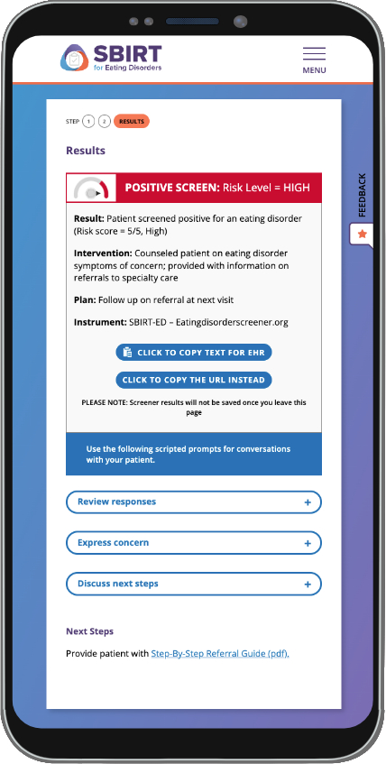
Screening Tool – SBIRT-ED
Developed based on vetted SCOFF screening tool (with much better name!)
Free on-line app
Will not catch everyone – consider asking “do you wonder if you have an eating disorder?”

Slide 22
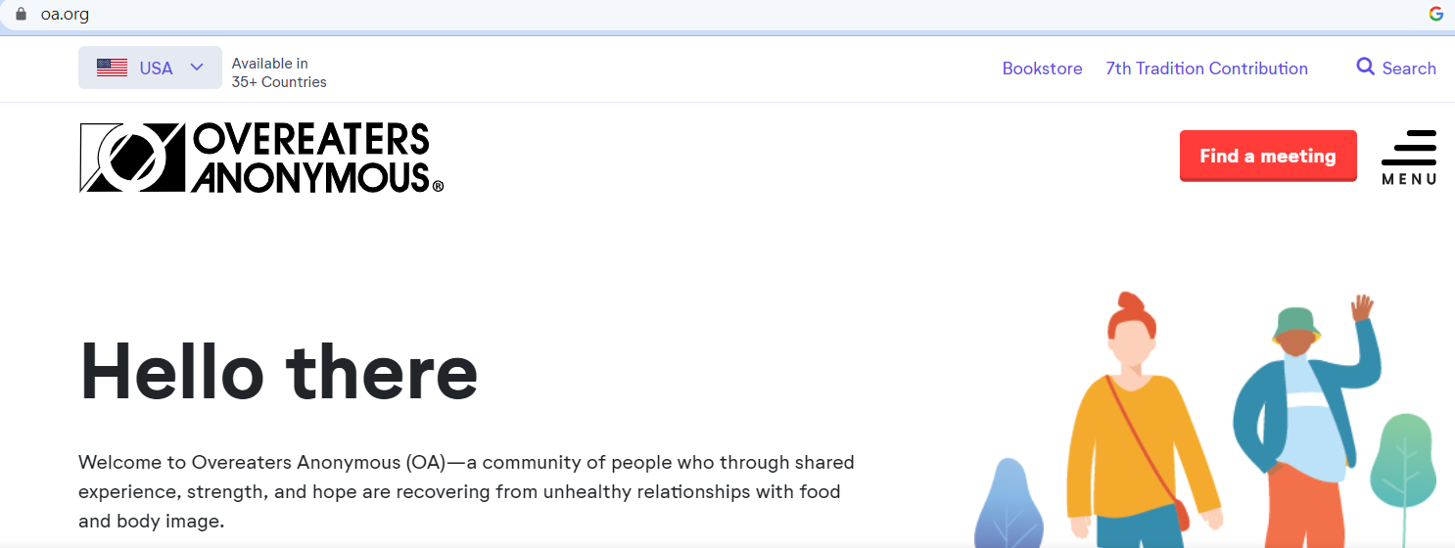

Slide 23
Questions? Comments? Learning points for me?
Melissa Robinson MD
828-779-1188 (cell)
Robinsonmd@etsu.edu

