Slide 1
Health Literacy in Rural Appalachia
Tom Kincer, MD
Professor and Associate Dean for Rural and Community Programs

Slide 2
Disclosures
Nothing to disclose

Slide 3
Objectives
To define health literacy
To examine the health literacy in rural Appalachia
To show the impact of low literacy on disease states

Slide 4
Define Health Literacy
Initially, health literacy referred to an individual’s ability to understand healthcare information to make appropriate decisions (S. C Ratzen & R. M. Parker, 2000).
However, the definition has expanded and for the Healthy People 2010 initiative, health literacy was defined as “the degree to which individuals have the capacity to obtain, process, and understand basic health information and services needed to make appropriate health decisions” (Ratzen & Parker, 2000).

Slide 5
Health Literacy versus Health Knowledge
Literacy may be thought of as the “ability” to obtain, process, and understand.
Whereas, knowledge can be thought of as knowing facts and data.
Believing and knowing are different (see next slide)
Given this, one can be literate but not knowledgeable
But, it’s difficult to be illiterate yet knowledgeable

Slide 6
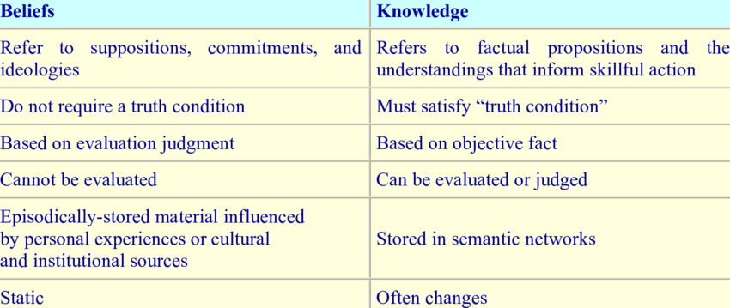

Slide 7
Supporting Patient Needs
From this definition, healthcare providers can see that they need to support the health literacy of patients by providing health information in a manner that promotes comprehension and supports healthcare decision making.
By understanding the health literacy abilities of the Appalachian population, nurses and other healthcare professionals can better develop education that supports comprehension and appropriate healthcare decision making.

Slide 8
What We Know…
Appalachian people are less healthy than other parts of the country.
Appalachian people are twice a likely to be uninsured.
Every mortality indicator is higher in the region than in the nation overall: heart disease is 17 percent higher; cancer is 10 percent higher; COPD is 27 percent higher; injury is 33 percent higher; stroke is 14 percent higher; and diabetes is 11 percent higher.
Years of Potential Life Lost is 40% higher in distressed regions of Appalachia than other parts of the country.

Slide 9
But Why?
Access to Healthcare
Higher rates of smoking: 25% vs 16%
Lower rates of education: 58% H.S. graduation rate in distressed Appalachia
Lower income: 20% poverty rate vs 11%
Culture
Health literacy

Slide 10
Culture
Appalachian people, especially the rural population, tend to approach their family members and religious leaders first with personal, family, or health problems.
Because of the years of external exploitation and stereotyping, Appalachians are slow to tell outsiders about family business.
Due to the high rates of trauma and exposure to adverse events through the life cycle, many people consider these events part of life, but still exhibit symptoms of trauma-related disorders.
This culture values “down to earth” more than “expert opinion”.

Slide 11
Components of Health Literacy
Education levels
Cultural beliefs
Prose, Document, Quantitative literacy
Availability of Health Care
Availability to receive health care
Language
Poverty

Slide 12
Literacy Levels
Below basic literacy level is described as “no more than the most simple and concrete literacy skills”
Basic literacy level refers to “skills necessary to perform simple and everyday literacy activities”
Intermediate literacy level encompasses “skills necessary to perform moderately challenging literacy activities”
Proficient literacy refers to “skills necessary to perform more complex and challenging literacy activities”

Slide 13
National Distribution
14% had below basic health literacy.
22% had basic health literacy
53% had an intermediate level of health literacy.
12% scored in the proficient range.
Overall, 36% of the adult participants had basic or below basic health literacy skills. This represents more than one third of the population (Kutner et al., 2006).

Slide 14
Identifying Literacy Levels
Assume lower than average literacy levels until proven otherwise.
Be aware of red flags
  Medications not being used correctly
  Unable to use basic medical terms
  Not following advice
Ask respectfully
Have them repeat explanations/instructions back to you

Slide 15
General Approach
Ask patients if they need help filling out forms or working a Kiosk.
Ask patients if they have internet at home and how they use it.
Ask all patients if they have trouble reading or seeing written words.
Ask all patients if they understand the instructions on their pills.
While highest level of education achieved has some correlation with literacy it is not a reliable predictor as 10% of college educated patients are somewhat health illiterate.

Slide 16
Why is this Important
If patients can’t understand, they are more likely to be non-adherent.
Patients usually will not tell the provider they do not understand
Non-adherence results in poorer outcomes or death
Patients respect providers who show complete interest done with a non-threatening approach. (create a safe space, words matter)

